Slide 1
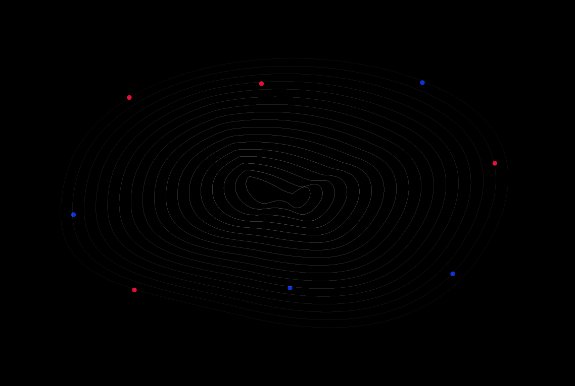
Welcome To
GoMyCode

Slide 2
Intro to CSS

Slide 3
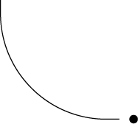
SUMMARY
1
Intro to CSS
2
Intro to Flexbox
3
What is Responsive Web Design?
4
CSS Media Queries

Slide 4
Notes:
Javascript yrod la page dynamique
Na7na chnerakzou 3al HTML w CSS 5ater el nes elkol yesta3louhom

Slide 5

CSS is a Style Sheet language that describes the style of an HTML document:
Colors
Backgrounds
Font style
CSS describes how HTML elements should be displayed.
Notes:
Css kima 7kina houa nzaynou bih notre page, ne5dmouh fi fichier wa7dou kima nektbou code html fel fichier « .html » nektbou code css fi fichier « .css »
Najmou on style directly onto the html file (it’s called inline styling) but we don’t. 3leh?
We should separate the files because it makes our code easier to read (mano93edch nlawej fi west el code html 3al style), our website faster and our styling more consistent throughout our website

Slide 6
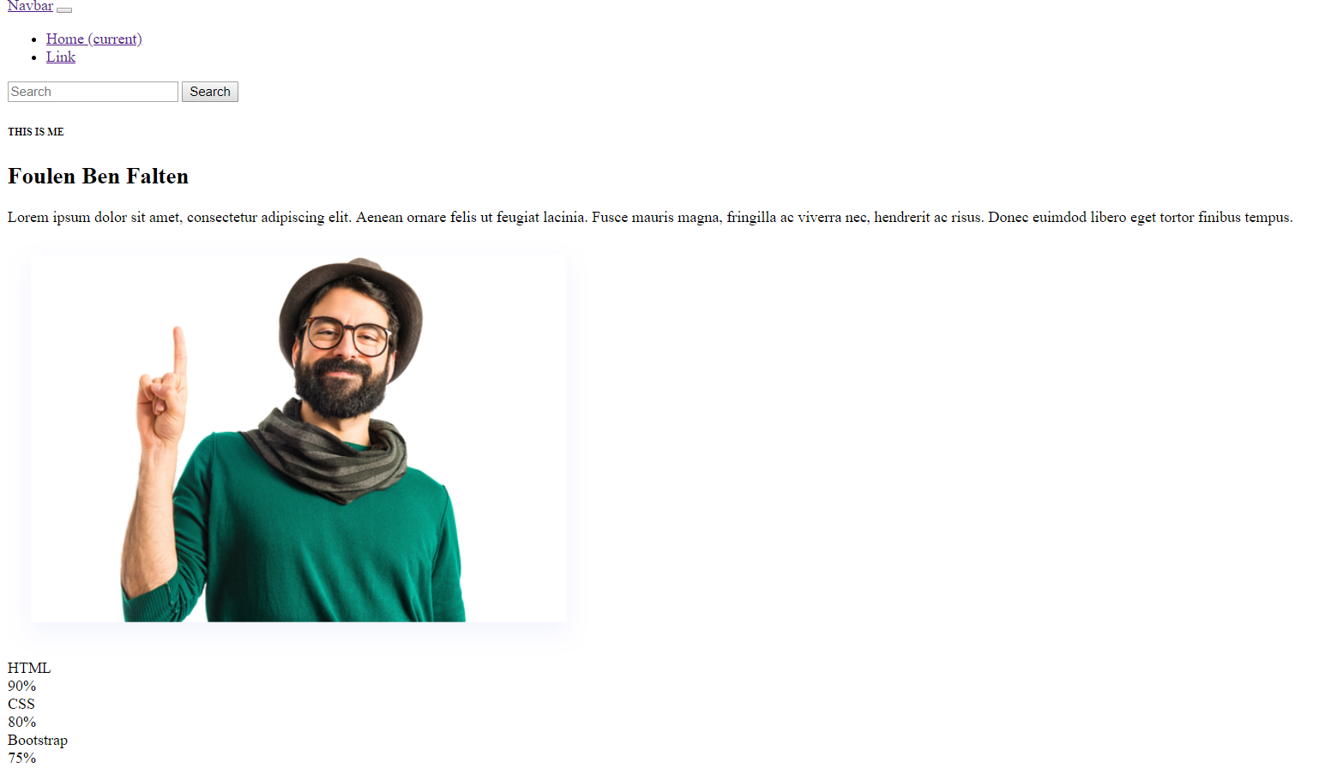
PURE HTML

Slide 7
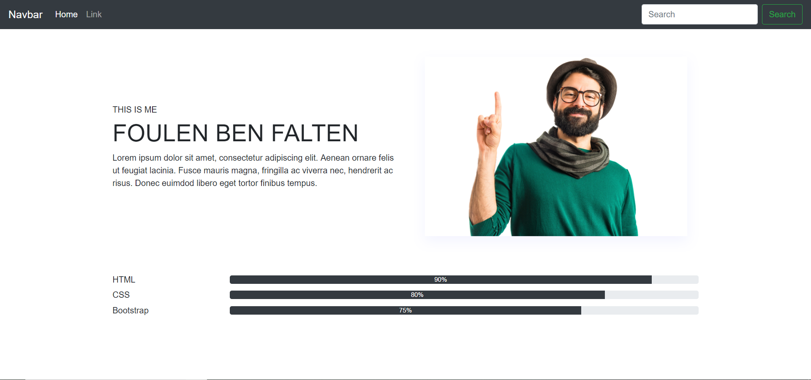
HTML & CSS
Notes:
SHOW THE NAVBAR, the text and the skills in both pages

Slide 8
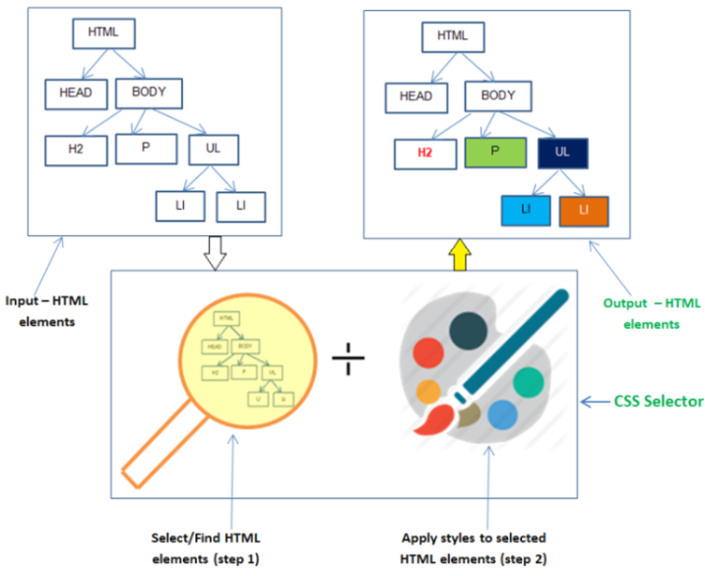
HOW DOES IT WORK?
Notes:
We write the HTML code than select it with css (kifeh on selectionne is called CSS selectors and are one of the most important things in CSS w bech na3rfouhom akthar in the next slide)
Finally, we apply the styles

Slide 9
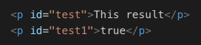
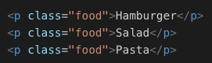
CSS SELECTORS
We have 3 types of selectors:
By tag (h1, p, div) (to apply the same style to all the tags with the same type)
By id (to give a unique tag a style)
By class (to regroup different tags and give them the same style)
Notes:
9olna elli les css selectors houma elli na5tarou bihom chnoua n7ebou nbadlou fel code html,
3anna 3 types de selectors:
Fel by class n9olhom (same font-color for example)
In the next slide we will see examples

Slide 10
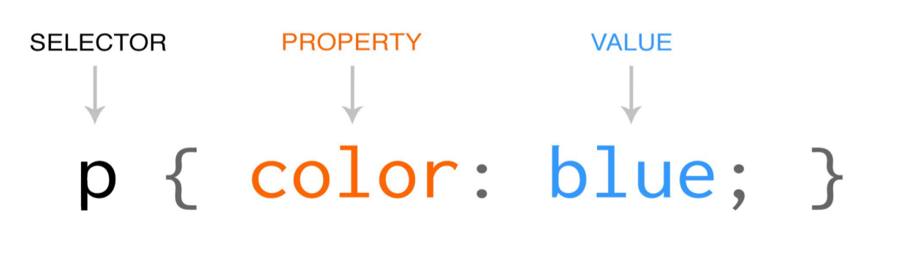
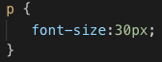
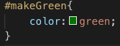
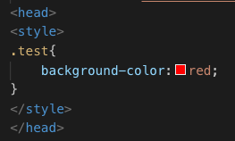
CSS RULES
A CSS rule-set consists of a selector and a declaration block
Notes:
After the selection we apply the styling
Try in console

Slide 11

CSS BOX-MODEL
All HTML elements can be considered as boxes. The CSS box model is essentially a box that wraps around every HTML element.
It consists of: margins, borders, padding, and the actual content.
Notes:
After the selection we apply the styling
Try in console

Slide 12

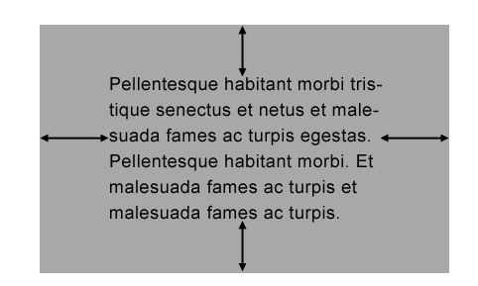
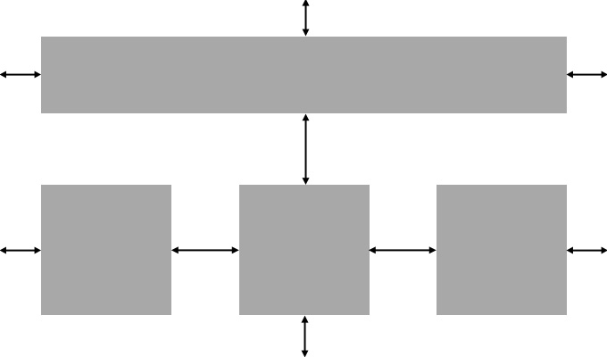
MARGIN & PADDING
Padding
Margin
Notes:
After the selection we apply the styling
Try in console

Slide 13
Intro to Flexbox

Slide 14


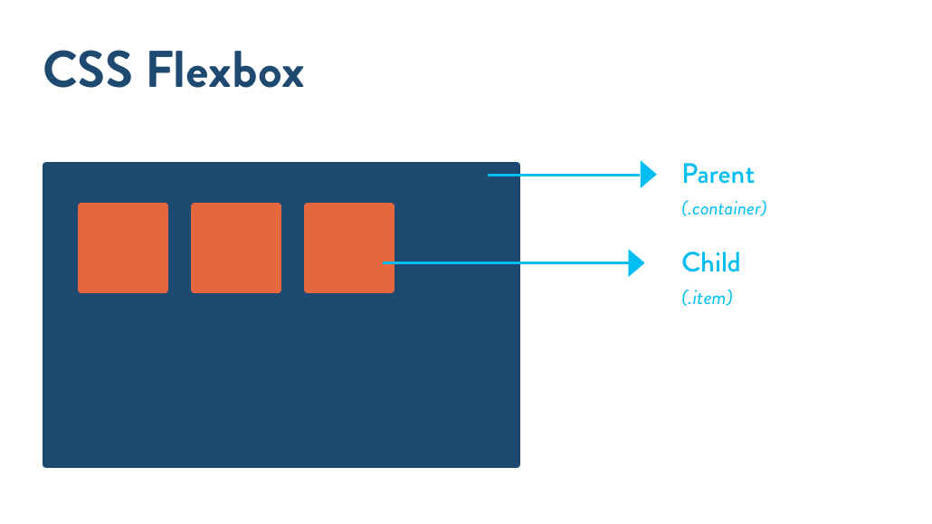
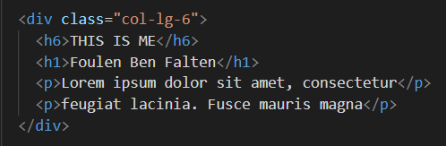
A set of CSS properties activated by the magic word: “Display: flex”
Transform children elements into flexible items inside their parent
Manage their position in the flexbox container
Parent
child 1
child 2
child 3
child 4
End of Parent
Notes:
Houma par défaut les éléments yjiw ta7t b3adhhom menghir css
We’ll see examples in the next slide

Slide 17
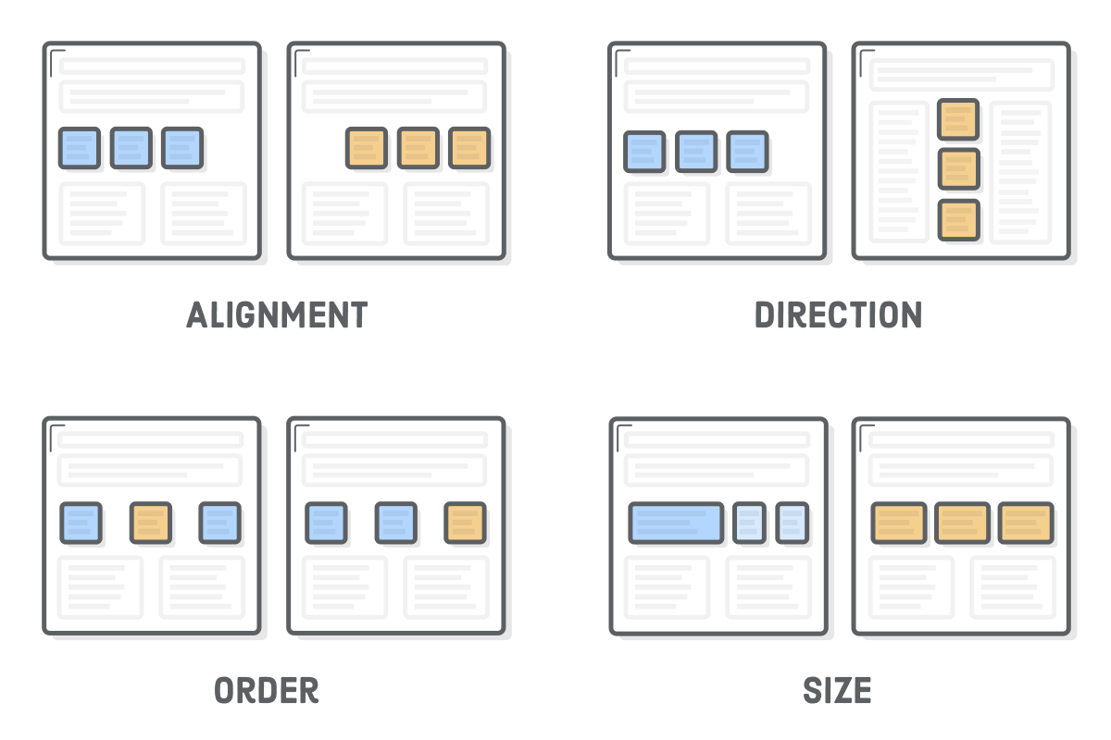
To recap, the Flexbox properties can affect :

Slide 18
What is Responsive Web Design?

Slide 19
Notes:
Responsive web design is an approach whereby a designer creates a web page that “responds to” or resizes itself depending on the type of device it is being seen through. That could be an oversized desktop computer monitor, a laptop or devices with small screens such as smartphones and tablets.
nwa

Slide 20
CSS Media Queries
Notes:
We covered the basics w taw Chnod5lou fel responsive

Slide 21
The @media rule, makes it possible to define different style rules for different screen sizes.
SYNTAX
@media TYPE and (WIDTH:(min or max or both)) { // your normal CSS code }
Example
@media screen and (max-width: 600px) { body { background-color: red; } }
Notes:
We’re gonna see the media types and width in later slides

Slide 22
MEDIA TYPES
all | Used for all media type devices
print | Used for printers
screen | Used for computer screens, tablets, smart-phones etc.
speech | Used for screen readers that "reads" the page out loud

Slide 23
BREAKPOINTS
// Extra small devices
@media (max-width: 576px) { ... }
// Small devices (landscape phones, 576px and up)
@media (min-width: 576px) and (max-width: 768px) { ... }
// Medium devices (tablets, 768px and up)
@media (min-width: 768px) and (max-width: 992px) { ... }
// Large devices (desktops, 992px and up)
@media (min-width: 992px) and (max-width: 1200px) { ... }
// Extra large devices (large desktops, 1200px and up)
@media (min-width: 1200px) { ... }
Notes:
Breakpoints ma3netha fi 2ena width yetbadal css la page
Tnajam tasna3 ay breakpoint t7eb 3liha (t7ot el width elli t7eb 3lih) ama famma des width standards houma akthar w7id mosta3mlin

Slide 24
Thank You

